Slide 1
Deep Molecular Response to Nilotinib As First-Line Treatment of BCR-ABL+ CML in Early Chronic Phase: A Phase 3b Multicenter Study of the GIMEMA CML Working Party
Abstract 4532
Castagnetti F, Gugliotta G, Breccia M, Martino B, Rossi G, Stagno F, Turri D, Tiribelli M, Trabacchi E, Isidori A, Pierri I, Leonardi G, Pregno P, Carella AM, Bochicchio MT, Testoni N, Soverini S, Specchia G, Alimena G, Cavo M, Martinelli G, Pane F, Saglio G, Baccarani M, Rosti G, on behalf of the GIMEMA CML Working Party

Slide 2
Background
In the ENESTnd trial, nilotinib (NIL) showed higher major molecular response rates with respect to imatinib (IM), with less frequent progression to advanced phases. Based on these results, NIL has been approved as front-line treatment of CML in chronic phase.
Treatment-free remission (TFR) is an emerging goal of CML treatment and a sustained deep molecular response (DMR, MR^{4.0} or better) is a prerequisite to discontinue TKIs. The 5-year update from the ENESTnd trial showed a superiority of NIL over IM in terms of both MR^{4.0} and MR^{4.5}, but differences in the stability of DMR have not been reported yet.
Despite the efficacy, cost and safety concerns may limit NIL use as first-line treatment in CML. Independent studies are extremely relevant to confirm or to extend the results of company-sponsored trials.
Castagnetti F, et al. Blood. 2014;124: Abstract 4532.

Slide 3
Study Aims
Primary objective: To assess the efficacy of NIL front line in terms of deep molecular response
Primary endpoint: rate of MR^{4.0} at 24 months
(preliminary results are presented here, because 18/130 patients have not completed the 24-month evaluation)
Key secondary objectives:
- evaluation of the kinetics of molecular response
- assessment of the safety profile
- evaluation of the outcome
Castagnetti F, et al. Blood. 2014;124: Abstract 4532.

Slide 4
Methods
Open-label, multicentric, prospective phase IIIb study
CML in early chronic phase (NCT01535391)
Starting NIL dose: 300 mg BID, with dose escalation to 400 mg BID in case of suboptimal response or failure (ELN 2009 criteria), with the exception of progression to ABP (in absence of toxicity or BCR-ABL mutations insensitive to NIL)
Analysis performed according to the ITT principle
Study duration: 6 years (1 + 5 years)
Enrollment
12 months
Study core
24 months
Follow-up
36 months
Castagnetti F, et al. Blood. 2014;124: Abstract 4532.

Slide 5
Patients N = 130
Years of age, median (range) 65 years or older, n (%) Sex male, n (%) Cytogenetics, n (%) CCA Ph+ Variant translocations Relative Risk, n (%) Low Intermediate High Months of follow-up, median (range) | 50 (18-85) 25 (19) 86 (66) 7 (5) 9 (7) Sokal Hasford EUTOS 56 (43) 65 (50) 120 (92) 48 (37) 58 (45) - 333 26 (20) 7 (5) 10 (8)3 24 (18-36)
Castagnetti F, et al. Blood. 2014;124: Abstract 4532.

Slide 6
Sensitivity
Samples with BCR-ABL ratio <0.1% IS
Number of ABL Copies | Percentage of Samples
<10.000 (MR^{3.0}) | 10%
10.000 - 31.999 (MR^{4.0}) | 52%
32.000 - 99.999 (MR^{4.5}) | 27%
>100.000 (MR^{5.0}) | 10%
Deep molecular response:
MR^{4.0} → detectable disease ≤0.01% BCR-ABL or undetectable disease with ≥10.000 ABL copies
MR^{4.5} → detectable disease ≤0.0032% BCR-ABL or undetectable disease with ≥32.000 ABL copies
Cross NC, et al. Leukemia. 2012;26(10):2172-5
Castagnetti F, et al. Blood. 2014;124: Abstract 4532.

Slide 7
Molecular Response at Each Timepoint N = 130
%
Intention-to-Treat Analysis
(not evaluable patients are considered as nonresponders)
CML 0811
Castagnetti F, et al. Blood. 2014;124: Abstract 4532.

Slide 8
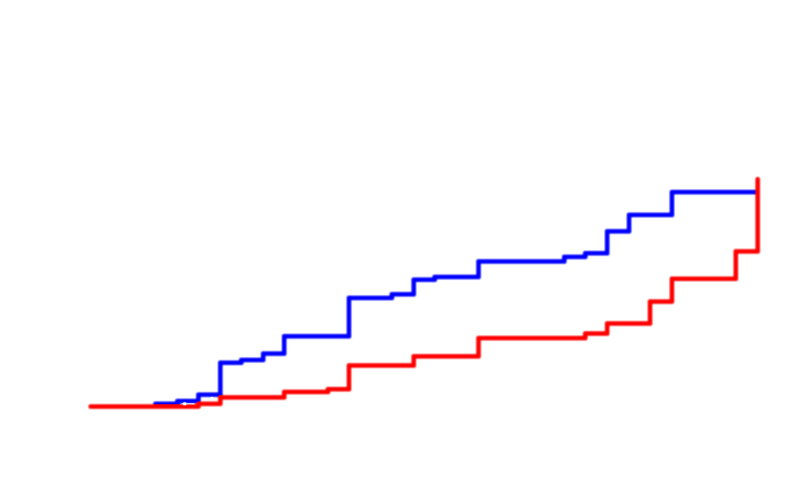
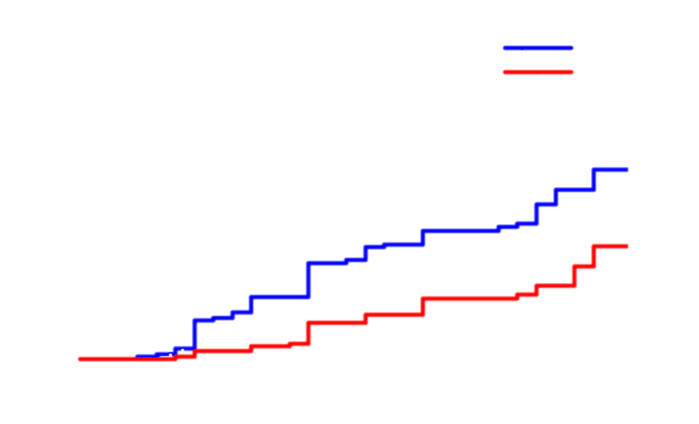
Estimated Cumulative Incidence of Deep MR
1.00 -
0.75 -
0.50 -
0.25 -
0.00 -
MR4
MR 4.5
Probability
47% (38 – 57%)
22% (16 – 31%)
0 6 12 18 24
Months
CML 0811
Castagnetti F, et al. Blood. 2014;124: Abstract 4532.

Slide 9
Stability of MR^{4.0}
Methods:
QPCR every 3 months
MR^{4.0}: ≤0.01% BCR-ABL^{IS} or undetectable BCR-ABL transcript with ≥10,000 ABL transcripts
Sustained MR^{4.0}: MR^{4.0} for at least 1 year, with at least 3 evaluable analysis
Patients achieving an MR^{4.0} 57/130 (44%)
Sustained MR^{4.0} 27/57 (47%, or 21% of total)
Castagnetti F, et al. Blood. 2014;124: Abstract 4532.
Notes:
9

Slide 10
Patient Disposition N = 130
Still on study Off-study Progression to AP/BP Failure Toxicity Other* | 107 (82%) 23 (18%) 2 (2%) 5 (4%) 11 (8%) 5 (4%)
*Loss to follow-up, consent withdrawal, pregnancy
All the enrolled patients are alive.
At the last contact, the patients still on treatment with NIL were 82%
75% with 600 mg, 5% with 300 mg or less, 2% with 800 mg daily
Castagnetti F, et al. Blood. 2014;124: Abstract 4532.

Slide 11
Cardiovascular Events
Overall incidence Coronary artery disease, n Arterial thrombosis, n QTc prolongation, n Atrioventricular block, n | 7/130 (5%) 3 2 1 1
Presence of cardiovascular risk factors at baseline.
The total cholesterol, and both LDL and HDL cholesterol fractions significantly increased during treatment.
Triglyceride concentrations had no significant variations.
A significant increase of HbA1c was not observed.
Castagnetti F, et al. Blood. 2014;124: Abstract 4532.

Slide 12
Summary
The incidence of deep molecular response rates seem to be superior to the historical data of IM.
The duration of observation is still too short to analyze the stability of deep molecular response, but NIL 300 mg BID as front-line treatment of BCR-ABL+ CML, with dose optimization in case of nonoptimal response, may improve the proportion of patients able to discontinue TKI treatment.
Due to the metabolic effects, a baseline evaluation of patients, including comorbidities, is important to maximize the therapeutic benefit and to minimize the cardiovascular risks.
Castagnetti F, et al. Blood. 2014;124: Abstract 4532.

